Slide 1
APUSH Review: Period 9 In 10 Minutes!

Slide 2
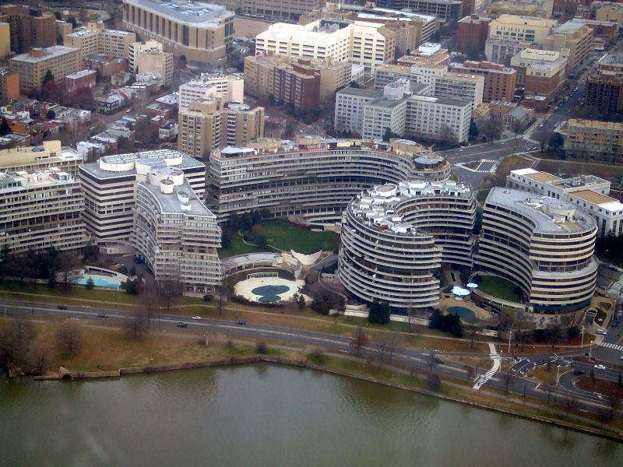
The Growth of Conservatism
Reasons for:
Decrease in public trust in government
Economic problems - stagflation and oil embargoes
Political scandals - Watergate, Pentagon Papers
Foreign policy “failures” - Iran Hostage Crisis
Social and Moral decay - rising crime, juvenile delinquency
Rise of evangelical churches

Slide 3
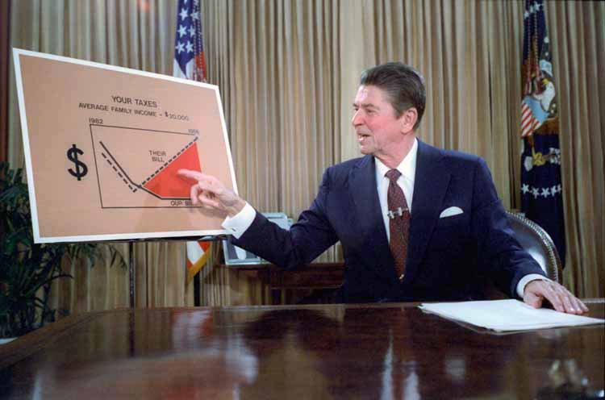
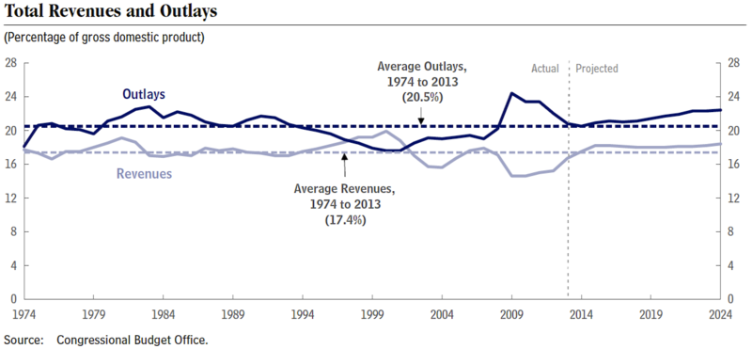
The Growth of Conservatism
Successes of the Conservative Movement:
Reduced taxes - Reaganomics, tax cuts under President George W. Bush
Reduced regulations of industries - less government involvement
Failures of the Conservative Movement:
Size of government grew despite denouncing “big government”
Moral ideas met opposition - Planned Parenthood v. Casey

Slide 4
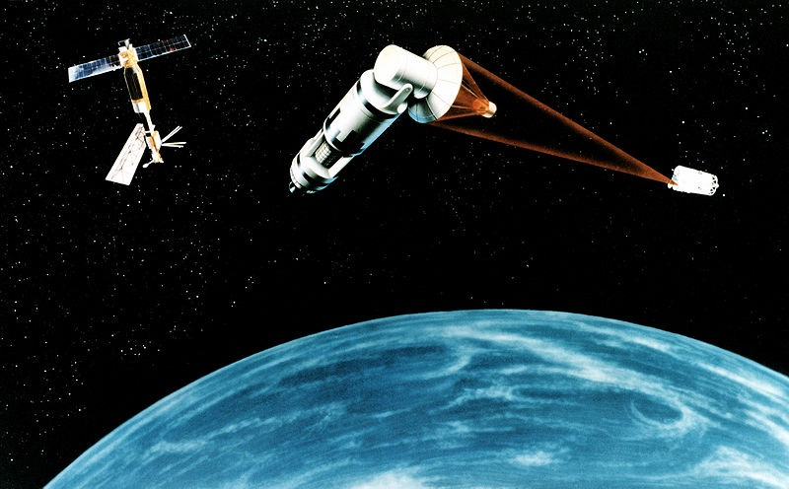
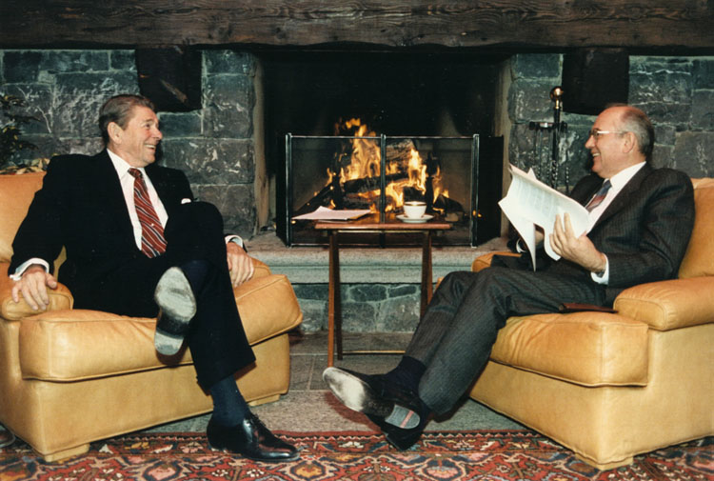
Reagan’s Presidency
Reagan and the Soviet Union:
Initially, he:
Rejected detente by increased defense spending - “Star Wars”
Used bellicose rhetoric - “Evil Empire”
In his second term, he:
Improved relations with Mikhail Gorbachev
Reduced weapons (Start I)

Slide 5
Post-Cold War World
US engaged in military and peacekeeping interventions:
Serbia - NATO bombings of Milošević
1st Gulf War
Post-9/11:
US engaged in lengthy conflicts in Afghanistan and Iraq
War on terrorism:
Sought to eliminate terrorist threats
Debates over protection of civil liberties - Patriot Act

Slide 6
US Economy Post 1980
Economic inequality increased due to:
Loss of manufacturing jobs (outsourcing)
Middle class has seen wages stagnated
Free trade debates:
NAFTA - some argue it led to outsourcing, others argue it led to lower cost for goods
Debates over government social safety nets:
Social Security Reform - baby boomers retiring
Health Care Reform - “Obamacare”

Slide 7
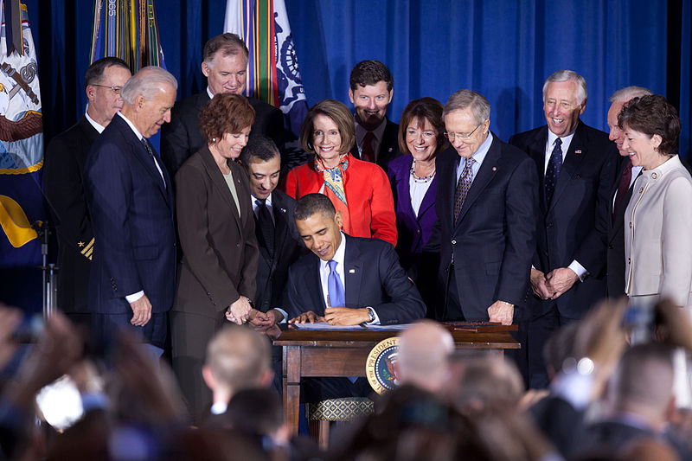
Environment and Demographics Post 1980
Middle East conflicts and climate change concerns has led to debates over US dependency on oil and fossil fuels
Immigrants from 1965 forward have largely been from Asia and Latin America
Traditionally underrepresented groups
Debates over immigration - Immigration Reform and Control Act of 1986
Population gains in the South and West (“Sun Belt”)
Debates over gays and lesbians:
“Don’t Ask, Don’t Tell” - overturned in 2011 by President Obama

Slide 8
Quick Recap
Reasons for the growth of conservatism (Great potential short answer)
Successes and failures of the conservative movement
Reagan’s interactions with the Soviet Union - how did it change over time?
War on Terrorism
Economy post 1980
NAFTA and free trade
Immigrants and environmental debates

Slide 9
Short Answer Question
Answer all three parts
The 1980s saw a rise in conservatism
a) Briefly explain one cause for the rise of conservatism
b) Briefly explain one success of the conservative movement
c) Briefly explain one failure of the conservative movement

