Slide 1
APUSH Review: Period 7 (1890 – 1945)

Slide 2
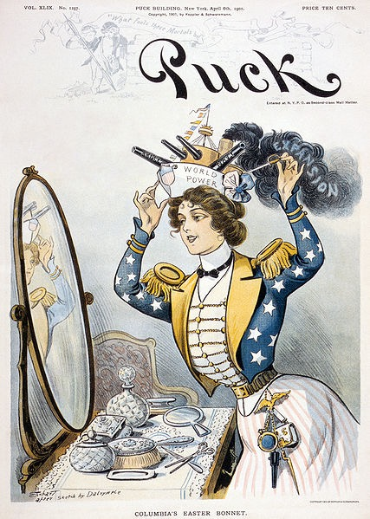
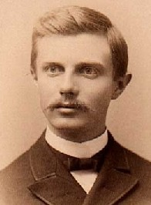
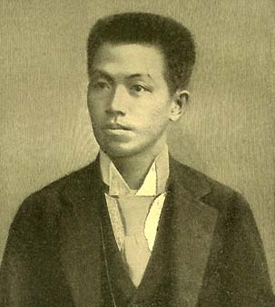
US Expansion Overseas
Reasons for:
“Closing” of the Frontier
Economic Motives
Racial Theories
Impacts?
Spanish-American War
US gained Guam, Puerto Rico, Philippines
Protracted insurrection in the Philippines
Debates between imperialists and anti-imperialists (similar to interventionists and isolationists)

Slide 3
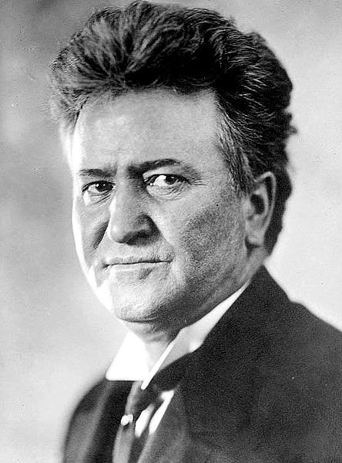
Progressive Era (1890 - 1920)
Progressive tended to be:
Urban, middle class, and be women
Progressives sought to:
Reform society socially and politically on the local, state, and federal levels
Use the federal government to regulate:
Businesses - Clayton Anti-trust Act
Economy - Federal Reserve
Environment - Teddy Roosevelt, John Muir
Expand Democracy - Initiative, referendum, recall, 17th and 19th amendments

Slide 4
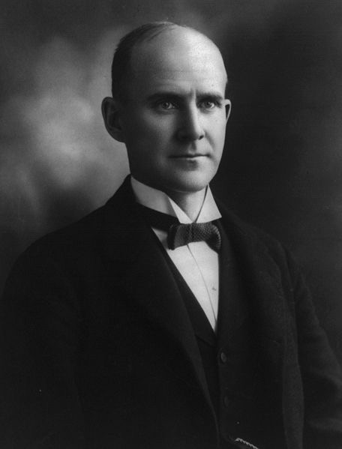
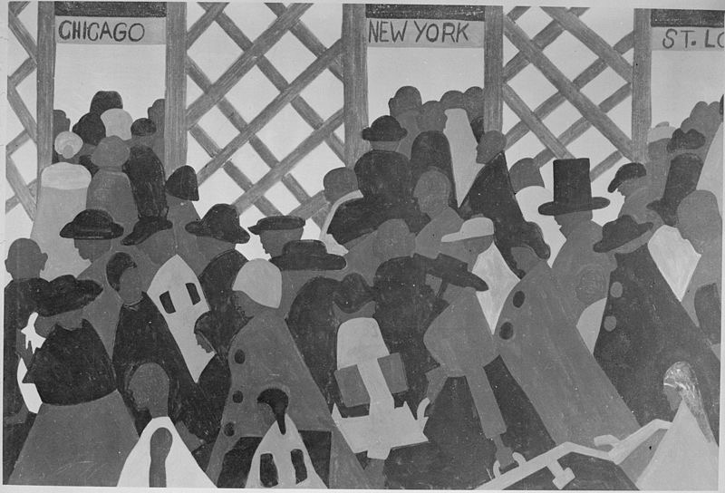
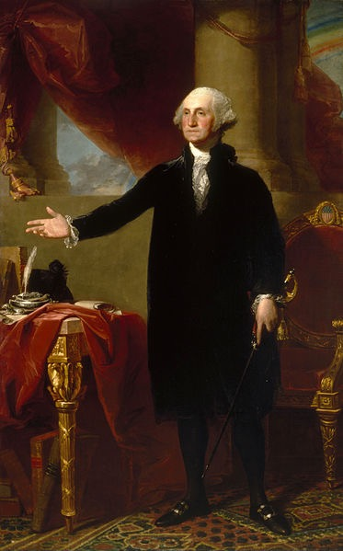
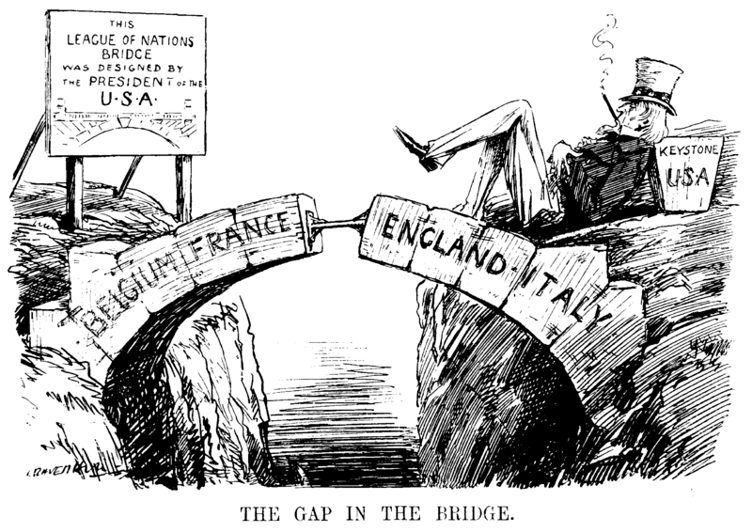
World War I
In my Farewell Address I warned of “entangling alliances” and political parties
WWI:
US initially was neutral, entered to “make the world safe for democracy”
Domestic life under WWI:
Restriction of civil liberties
Increased opportunities for women and African Americans
Great Migration
Treaty of Versailles and League of Nations
Wilson’s 14 Points heavily influenced the Treaty (minus punishment of Germany)
Ultimately, the US did NOT join the League - (Washington’s Ghost)

Slide 5
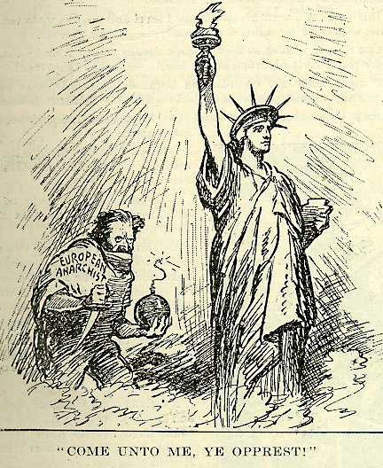
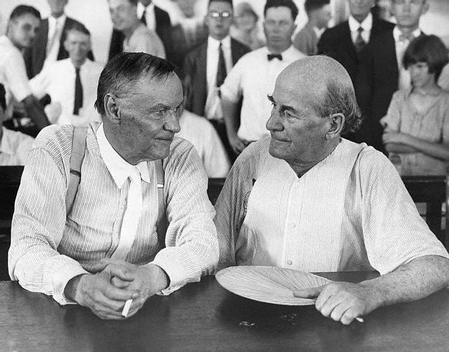
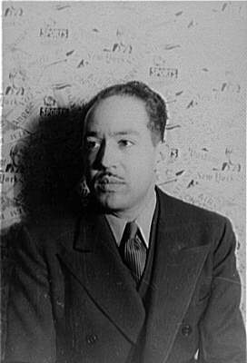
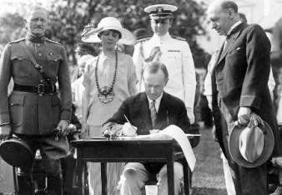
1920s
1st Red Scare - 1919-1920:
Caused by:
Russian Revolution, labor unrest, immigrants
Effects:
Suppression of radicals
Immigrants quotas (1921 - 1924) - later overturned in 1965
Impacts of technologies:
Improved standard of living, personal mobility, communication
Conflicts in the 1920s:
Fundamentalist Christianity v. Scientific modernism (Scopes Trial)
Native-born v. new immigrants
White versus black (Red Summer of 1919)
Urban v. rural (1920 census)
Harlem Renaissance:
Celebration of African American culture through art, writing, and music

Slide 6
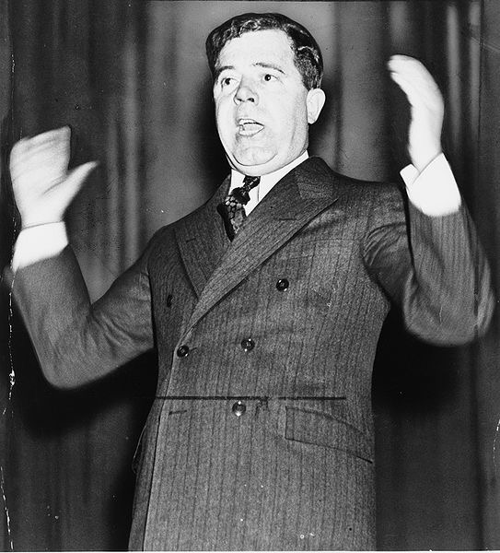
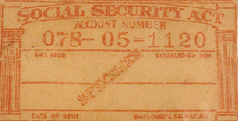
Great Depression/New Deal
Great Depression
Led to calls for a stronger financial regulatory system
New Deal:
Focused on relief, recovery, and reform
Used earlier progressive ideas (great potential continuity question)
Challenges to New Deal?
Supreme Court -> Packing plan, radials (Huey Long)
Impacts of the New Deal?
Legacy of reforms and agencies (Social Security, FDIC)
Political realignment - African Americans and unions began to vote Democratic

Slide 7
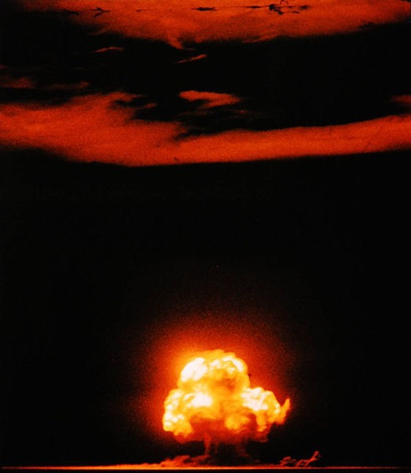
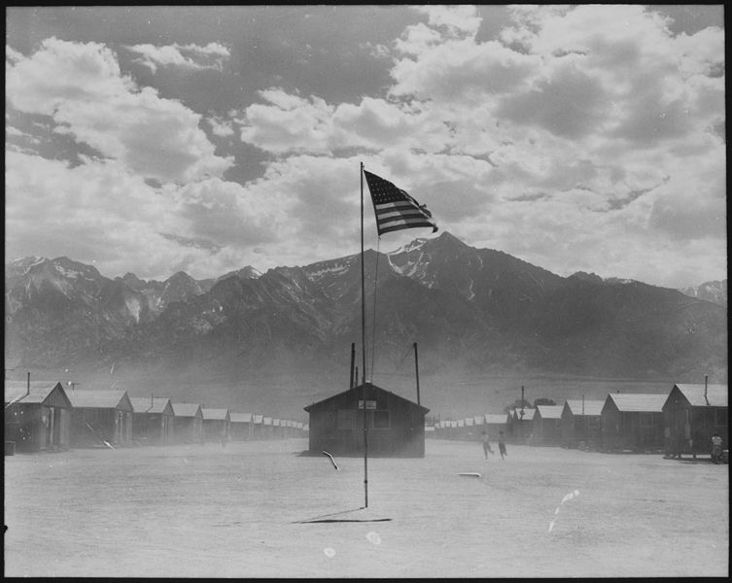
World War II
US was “neutral” until Pearl Harbor
Mass mobilization of the economy -> ended the Great Depression -> opportunities for women and minorities
Wartime experiences:
Japanese Internment
Debates over race and segregation - Double V Campaign, Zoot Suit Riot
Decision to drop the atomic bomb:
To save American lives, end the war quickly, etc.
Why did the US and its allies win?
Commitment to democracy, technological advancements (Manhattan project), industrial production
US post-war
Emerged as the most powerful nation - Europe law in ruins

Slide 8
Quick Review
Reasons for US expansion overseas
Spanish-American War
Who were Progressives? What were their goals?
Domestic life during WWI and WWII
Treaty of Versailles and League of Nations
The First Red Scare
Harlem Renaissance
Quota Acts
Great Depression
New Deal
WWII - atomic bomb, Zoot Suit Riots, Japanese Internment

