Slide 1
c.8000 BCE- c.600 BCE
AP World History Review
Unit 1

Slide 2
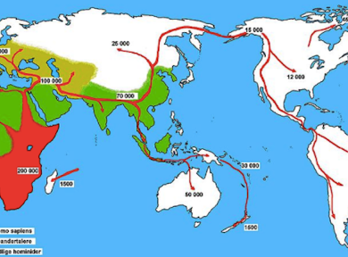
the peopling of the earth
Where did the first humans originate?
The first humans originated from south- western africa.
Climate
Climate has been a major factor in determining where people settled. Peopled settled in areas that has climates that would accommodate agriculture and livestock.

Slide 3
Time Periods
• The Paleolithic Age refers to about 12,000 BC. During this time people were nomadic.
• The Neolithic Age refers to the age from about 12,000 BC to about 8000 BC. It is during this time that people settled in communities and civilization began to emerge.
• River Valley Civilizations refers to about 3500 to 1500 BC. The major River Valleys
• Classical Civilizations refers to about 1000 BC to 600 CE. The major civilizations to emerge were Zhou and Han China, Greece and Rome, and the Gupta Empire.

Slide 4
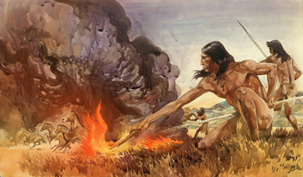
What diverse and sophisticated tools were developed by humans to adapt to their new environment?
Each early civilization developed its own unique ways of life, but they all shared some common characteristics:
Fire- Fire was used to adapt to their new environment,by keeping warm,cooking food, and for sanitation.
Weapons- Weapons were used as protection, and for hunting.
Complex irrigation systems
legal codes
money
art and written literature

Slide 5
The neolithic revolution and early agricultural societies
Beginning about 10000 years ago, the neolithic revolution led to the development of more complex economic and social systems.
Neolithic revolution = agricultural revolution

Slide 6
Places and their local available plant/animal (that was domesticated)
Mesopotamia: goat
Nile river valley: goat and wheat
Sub-saharan africa: sheep and coffee
Indus river Valley: sheep and rice
Yellow river valley: pigs and rice
Papua New Guinea: goats and sugarcane
Mesopotamia: turkey and maize
Andes: llama and potato

Slide 7
Agriculture and pastoralism began to transform human societies.
Agriculture and pastoralism
More reliable food supplies
Increased population
Creation of permanent settlements and rise of cities
Specialization of labor
Development of new classes of people including elites.
What impact did overgrazing have on afro-eurasian lands?
Overgrazing led to the erosion of grasslands.

Slide 8
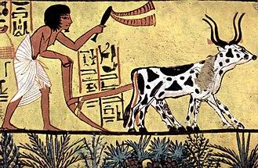
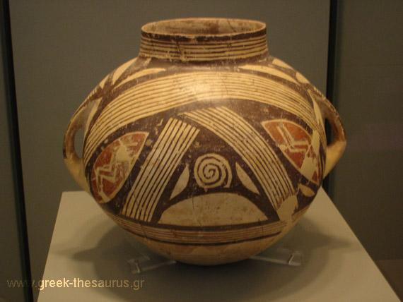
Early Agricultural Society
Innovation improvements helped agricultural production, trading and transportations.
Ex.
Pottery- used for trading and helped keep foods
Plows- made cultivation easier
Woven Textiles- used in trading and used to keep warm during cold weather
Metallurgy- used to make tools which made life easier
Wheels/ wheeled vehicles- good way for transportation

Slide 9
The development and interaction of early agriculture, pastoral and urban societies
Mesopotamia: tigris and euphrates river valley
Nile river valley: egypt
Indus river valley: harappa and mohenjo-daro
Yellow river valley: shang and zhou dynasties
Mesoamerica: olmecs
Andes: chavin

Slide 10
Comparing The River Valley Civilizations
Culture | Political Organization | Social Structure

Slide 11
Comparing The River Valley Civilizations
Culture | Political Organization | Social Structure

Slide 12
Comparing The River Valley Civilizations
Culture | Political Organization | Social Structure

Slide 13
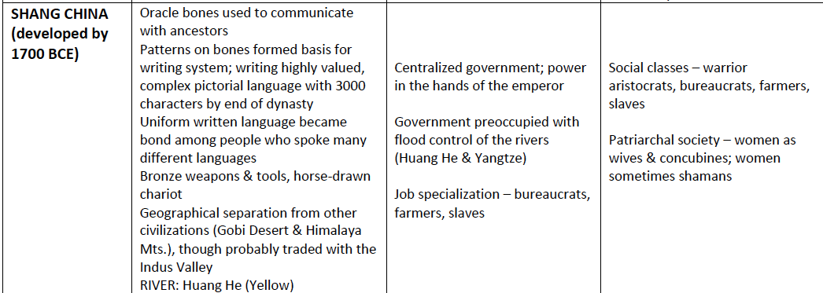
Comparing The River Valley Civilizations
Culture | Political Organization | Social Structure

Slide 14
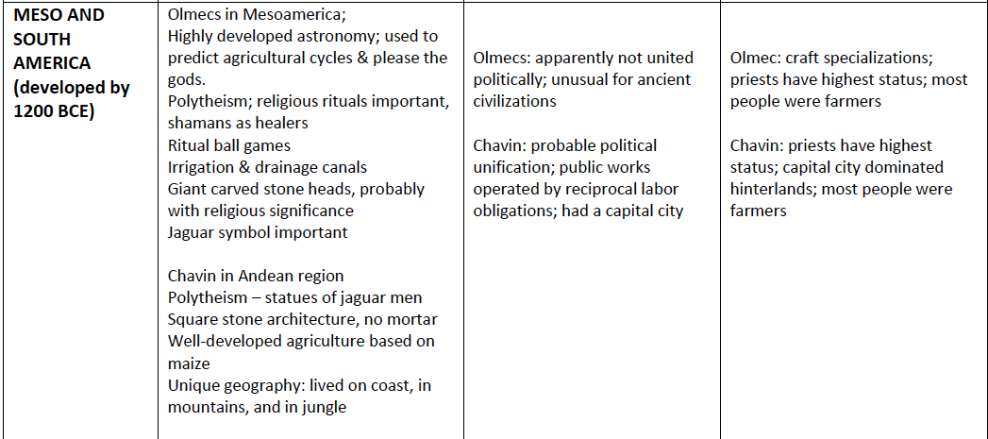
Comparing The River Valley Civilizations
Culture | Political Organization | Social Structure

Slide 15
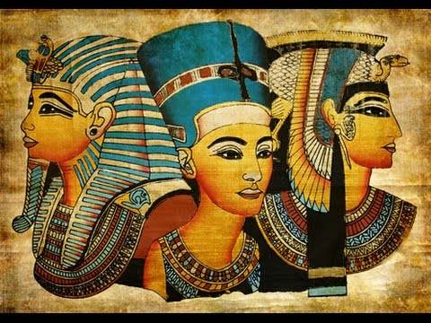
How rulers justified their power
During the early ages many mesoamerican, chinese,and egyption rulers justified power through “divine authority”, which is justification through religion.
People believed that a ruler was fit to be king if their God(s) appointed them, this idea of “divine authority” helped rulers gain “support” of the people to rule over them.

Slide 16
Impacts of these weapons and modes of transportation
Weapons (compound bow, iron weapons): Allowed for better protection and hunting leading to more food abundance.
Modes of transportation (chariot, horseback riding): the impact of the modes of transportation allowed soldiers and government agents cover long distances (the chariot) and horseback riding made it possible to travel and communicate.

Slide 17
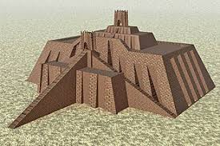
Culture through monumental art
The Ziggurat was created in the Mesopotamian civilization around 2900 B.C.E. It was a place for religious practices and rituals. Each city would have their own god and for every one they would have their own ziggurat.

Slide 18
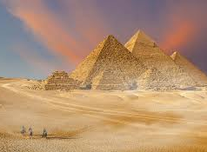
Culture through Monumental art
Pyramids were built in ancient Egypt around 2630 B.C.E, and they served as a place for carrying out funerary rites, location of royal tombs, that sustained the kings spirit in the afterlife.

Slide 19
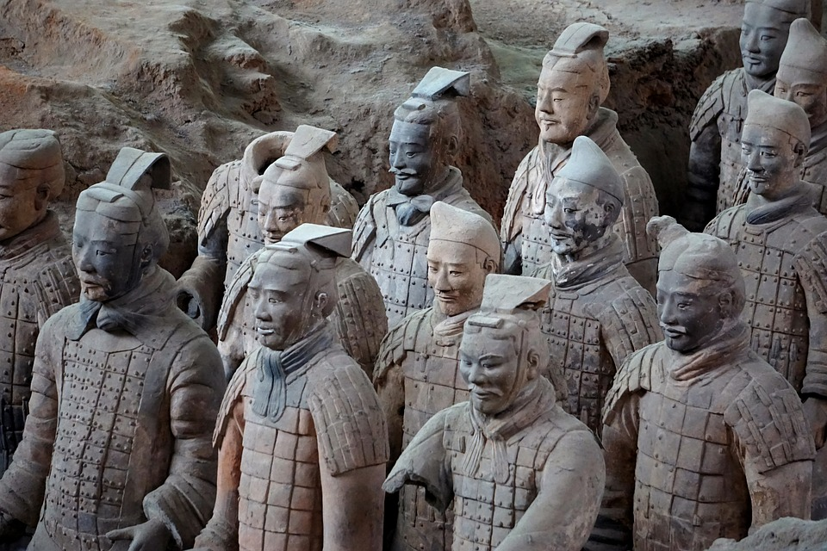
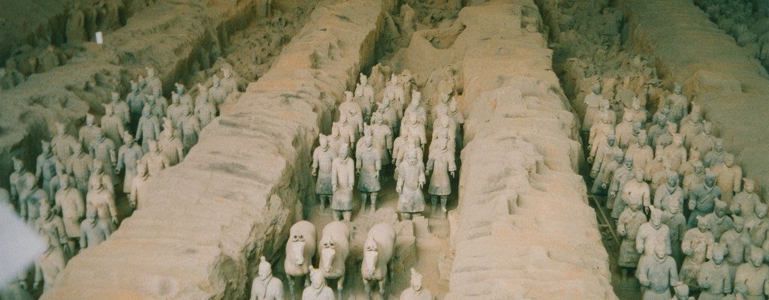
Culture through Monumental art
Terracotta army
The terracotta army was created by the Qin Dynasty civilization in approximately 220 bce. It was made to protect the emperor after his life. These statues were made from clay. All of the statues different there wasn’t one that was the same.

Slide 20
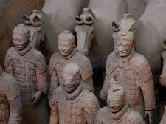
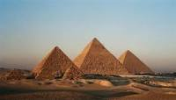
Importance of Architecture of the time
Terracotta Warriors
Egyptian Pyramids
Architecture was held in high importance at the time. Many forms of agriculture had important social and religious roles such as the Egyptian pyramids(2630) where royal tombs were held or The Terracotta Army made by the Qin Dynasty in China in 220 BCE was made to protect the emperor, who was going to the after life.

Slide 21
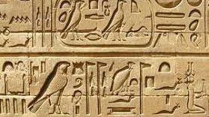
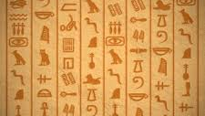
Culture Through Monumental Art
Hieroglyphics were created in Egypt,and they were used as pictographs. It was there own writing style and they believed it was invented for the gods.

Slide 22
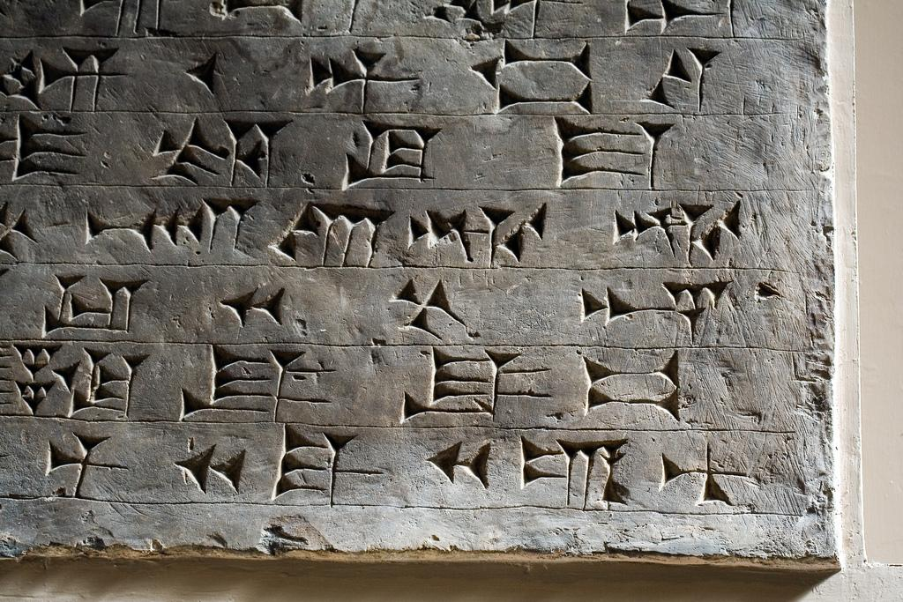
Culture Through Monumental Art
Cuneiform
Cuneiform was a type of writing system that the mesopotamian civilization created. A unique characteristic of the writing system was it used wedge-shaped writing.

Slide 23
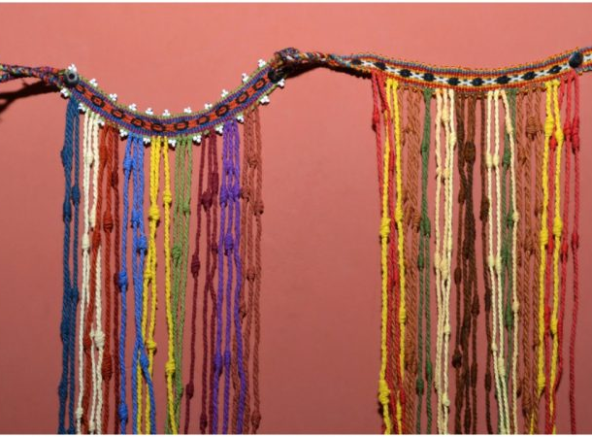
Culture Through Monumental Art
Quipu
Quipu was created in the Chaun(Andes) civilization.
The Incas used tying knots in colorful string to record dates and numbers.
They would mostly use it to tell and record stories, myths and poems
Astronomy, calendars, taxes, land measurements and armies equipment.

Slide 24
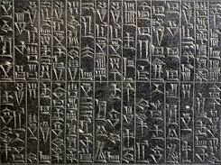
Aspects about the Code of Hammurabi
Some aspects of the code of Hammurabi are that laws were made to establish justice and fairness. The laws also created the idea that the kind are the only ones with Earthly Powers.

Slide 25
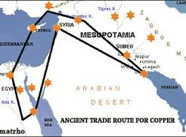
Trading throughout Europe and Africa
There was trading between Mesopotamia, china, and Africa. They would trade tools for agriculture, plants, and livestock.

Slide 26
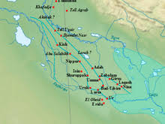
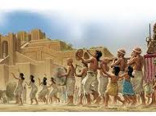
Ancient Civilizations
Sumer
Sumer is the earliest known civilization in the southern Mesopotamia region, which is modern day southern Iraq. The sumerians dominated southern Mesopotamia through the end of the third millenium BCE. They were responsible for the creation of the fundamental elements, such as irrigation, technology, and cuneiform.
Notes:
YOOOOOOOOOOOO whos doing these slides. -brianna

Slide 27
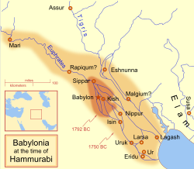
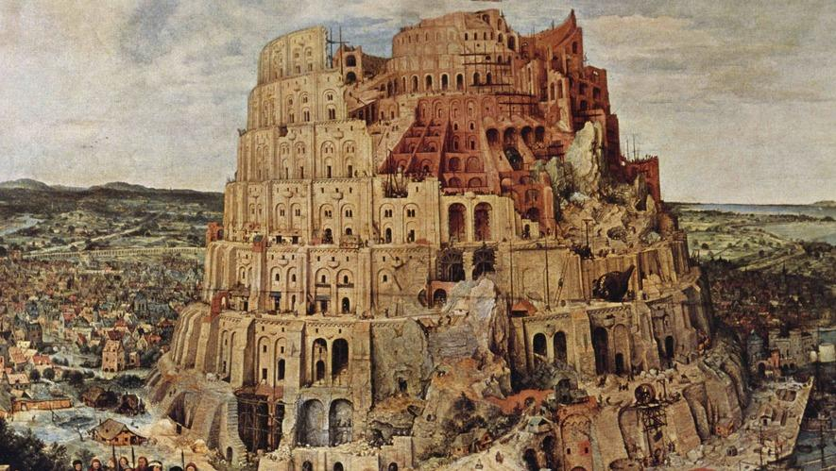
Ancient Civilizations Pt2
Babylon(2000-c.485)-
Babylon was formed by hammurabi into a strong and prosperous empire.It was the largest and most important city in mesopotamia, and it was the capital,until it was destroyed by sargon of akkad.

Slide 28
Vocabulary Quizlet
https://quizlet.com/_6eyyfy

